Slide 1


Empowering ​
Changemakers of
the Future
Department of Statistics & Actuarial Science
School of Computing & Data Science
The University of Hong Kong

Slide 2
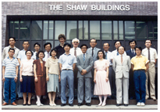
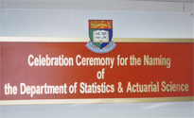

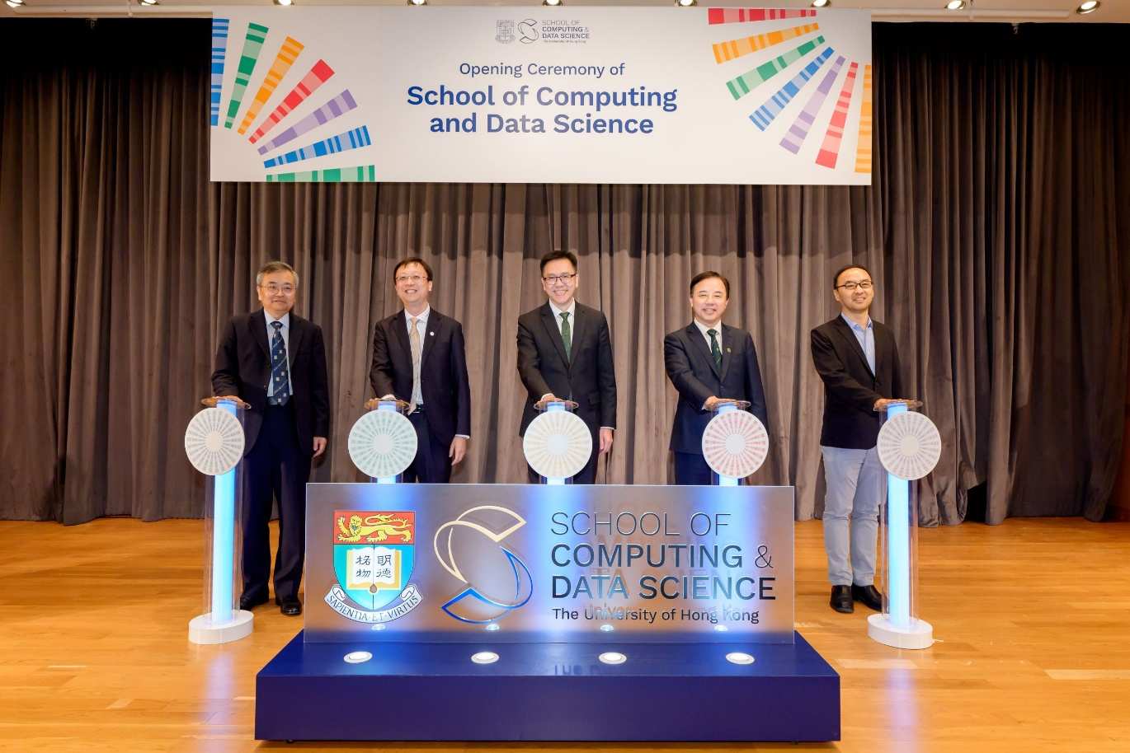
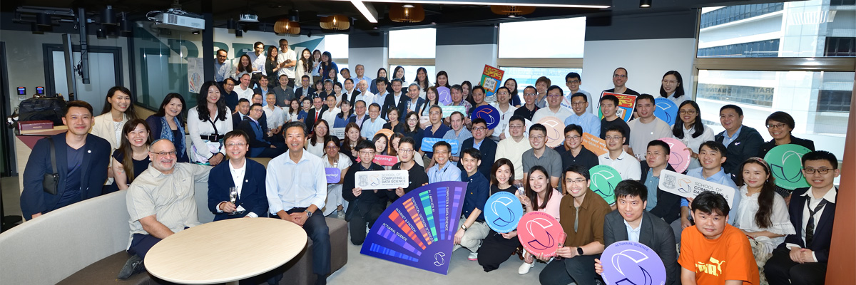
Background of SAAS
The Department of Statistics was established in 1967
Renamed as Department of Statistics and Actuarial Science in 1998
Joined forces with the Department of Computer Science to establish the School of Computing and Data Science in 2024
Academic Excellence:
  QS World University Ranking #32 for the subject Statistics and Operational Research in 2026
  Center of Actuarial Excellence
  Actuarial research in 2021-2025 ranked #9 worldwide and #2 in Asia

Slide 3

SAAS
UNDERGRADUATE PROGRAMMES

Slide 4
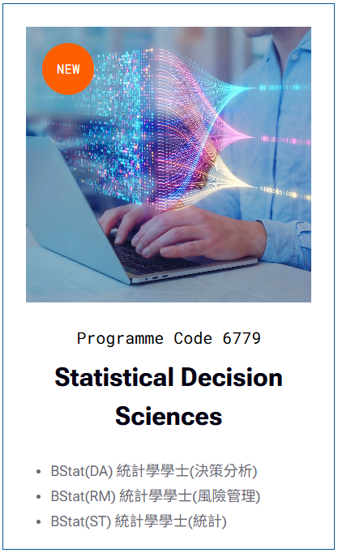

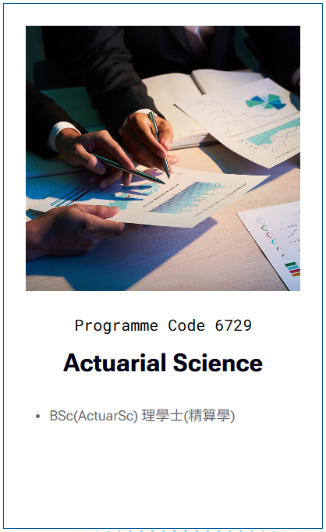



UG Programmes

Slide 5
UG Programmes
To better equip students with the skills and knowledge needed for success in their future careers, we organize numerous Professional Development activities: corporate mentorships, internships, individual career advising, Career Fair, firm visits, alumni sharing, etc.
Plenty of research opportunities for students aspiring to higher-degree studies and a research-oriented career

Slide 6
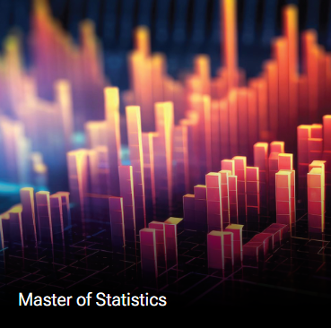
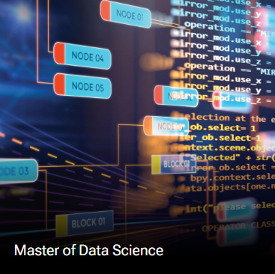
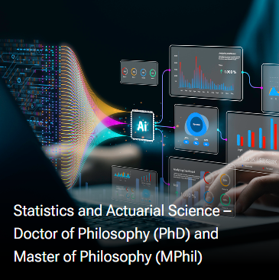
Higher Degree Programmes

Slide 7
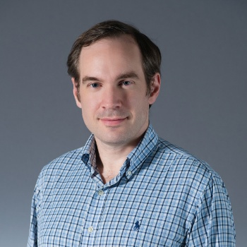
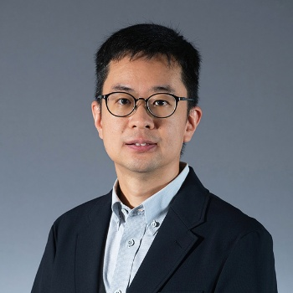
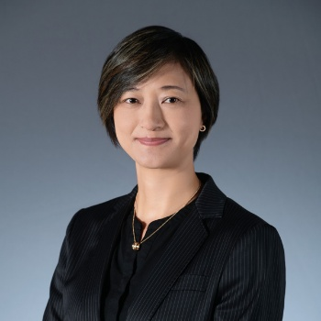
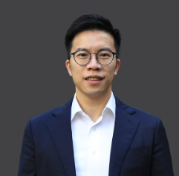
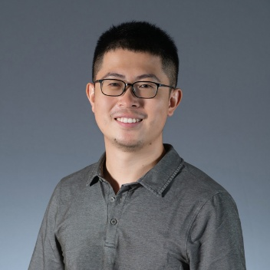
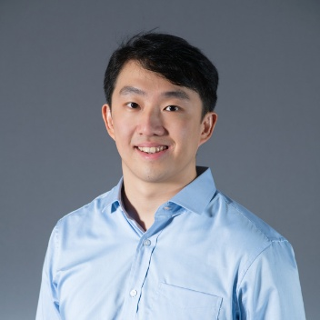
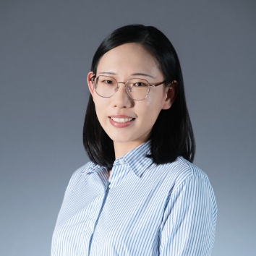
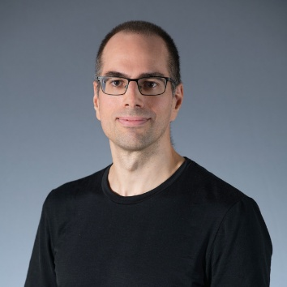
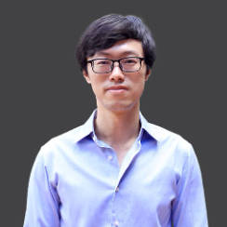
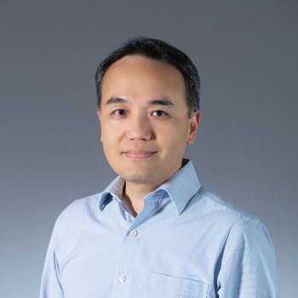
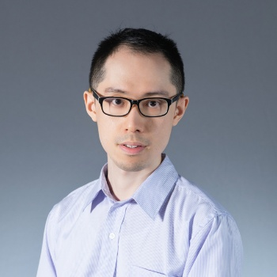
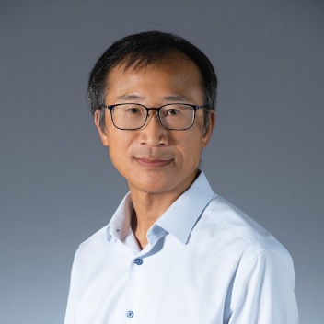
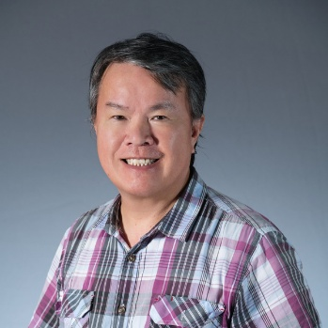
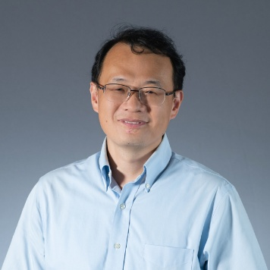
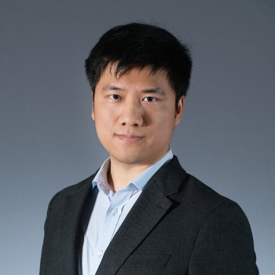
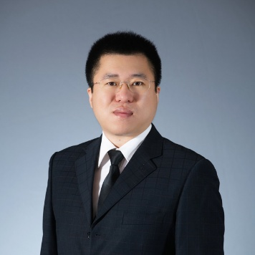
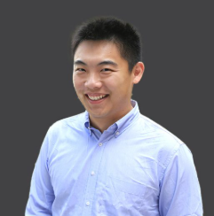
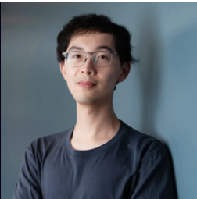
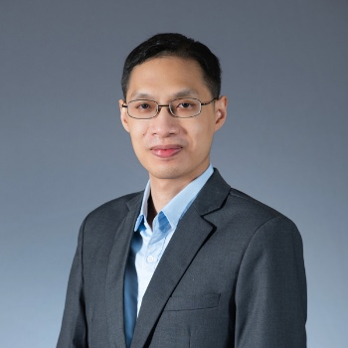
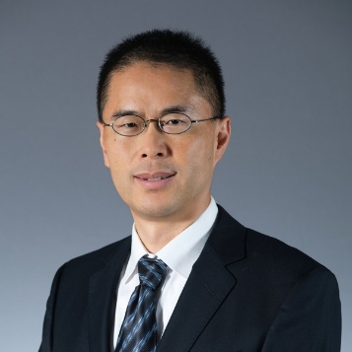
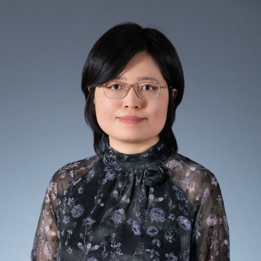
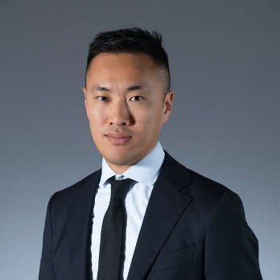
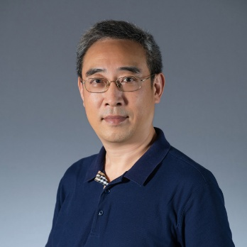
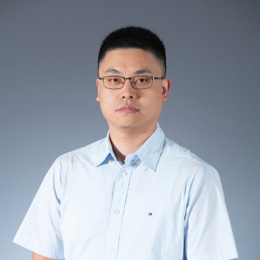
Teaching Staff
Prof. KC Cheung
Head
Prof. Stephen Lee
BStat Programme Director
Mr. Frankie Ng
Division Secretary
Email: saas@hku.hk
Mr. KL Ng
UG Admin Lead
Email:
ugenq@hku.hk
Dr. KP Wat
Associate Head
Dr. David Lee
BSc(ActuarSc) Programme Director

Slide 8
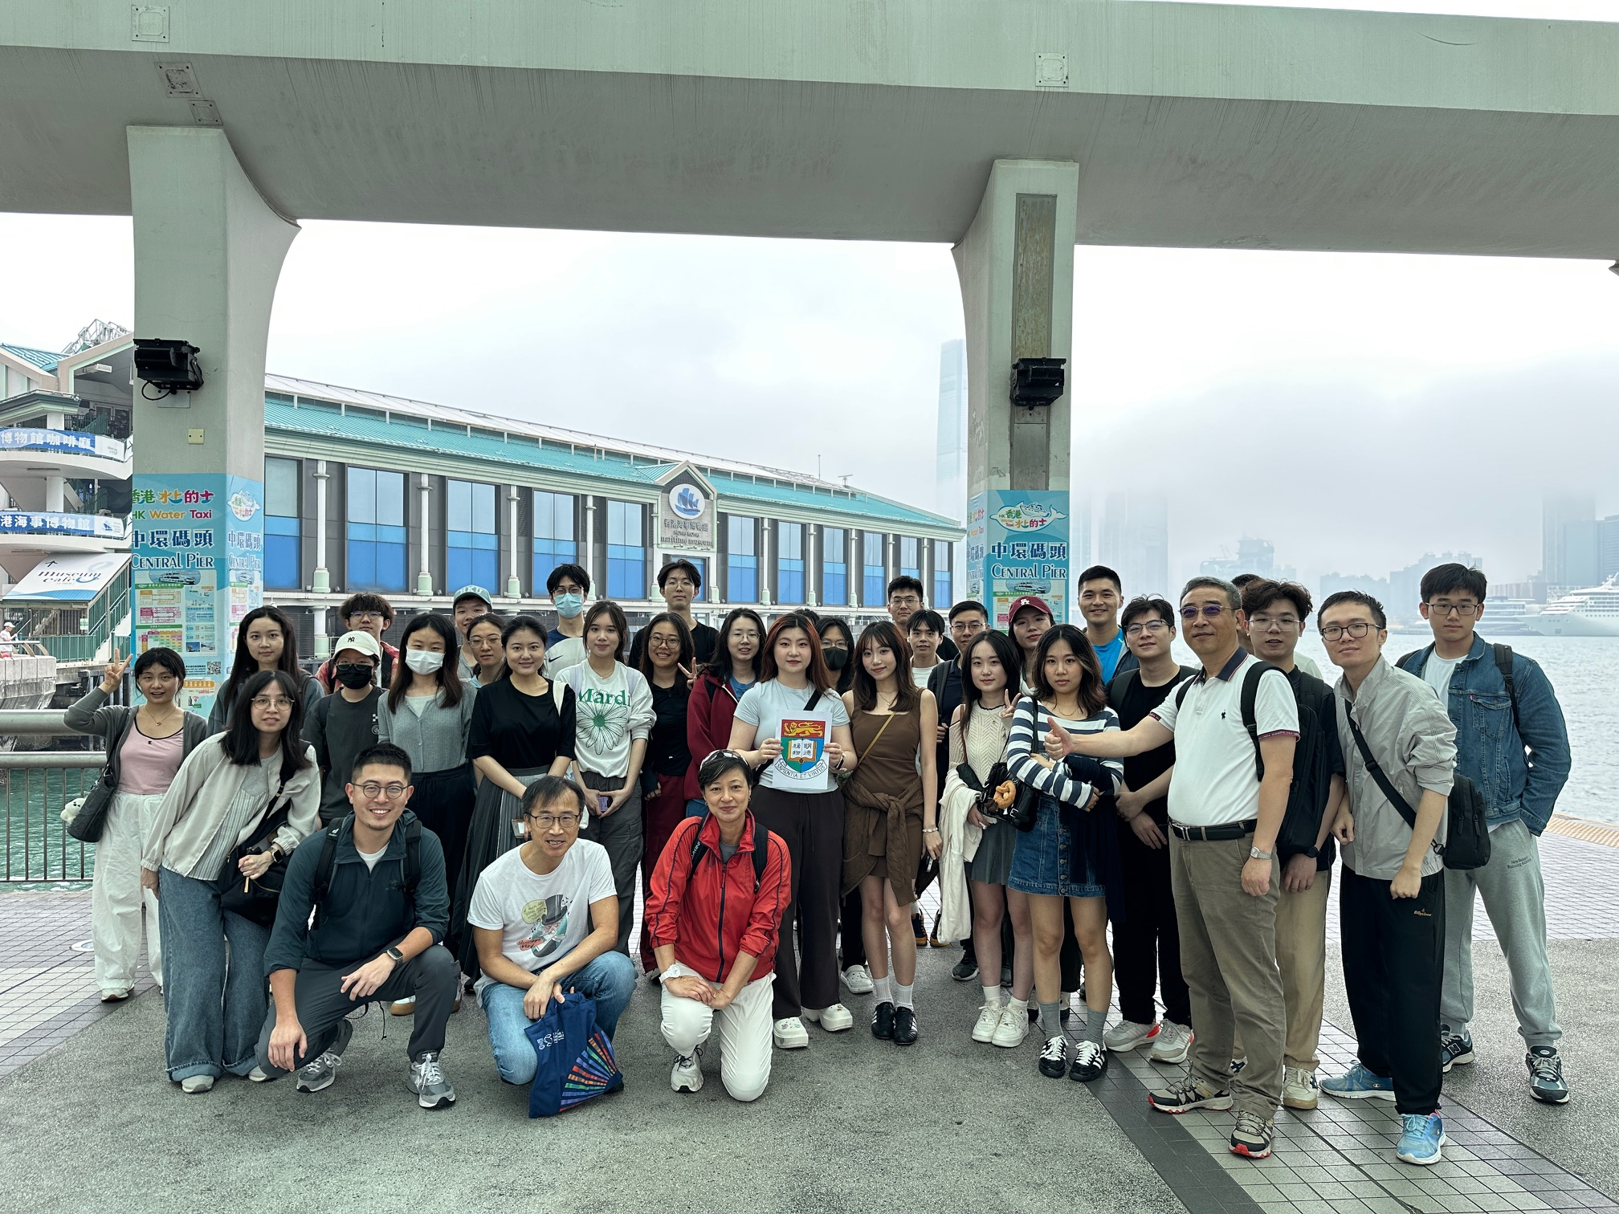
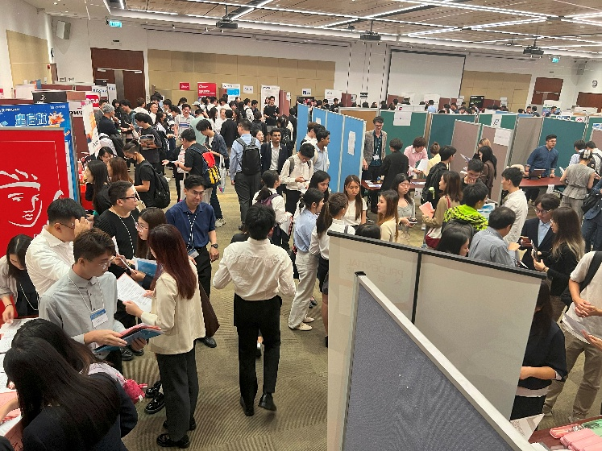
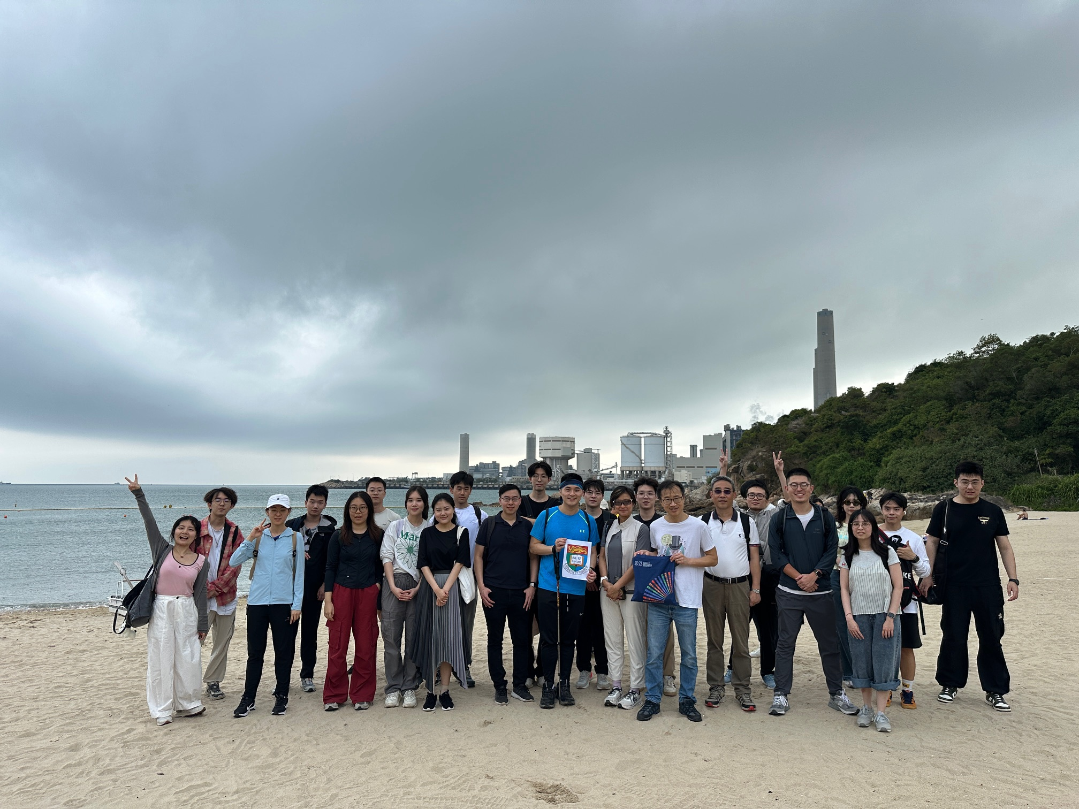
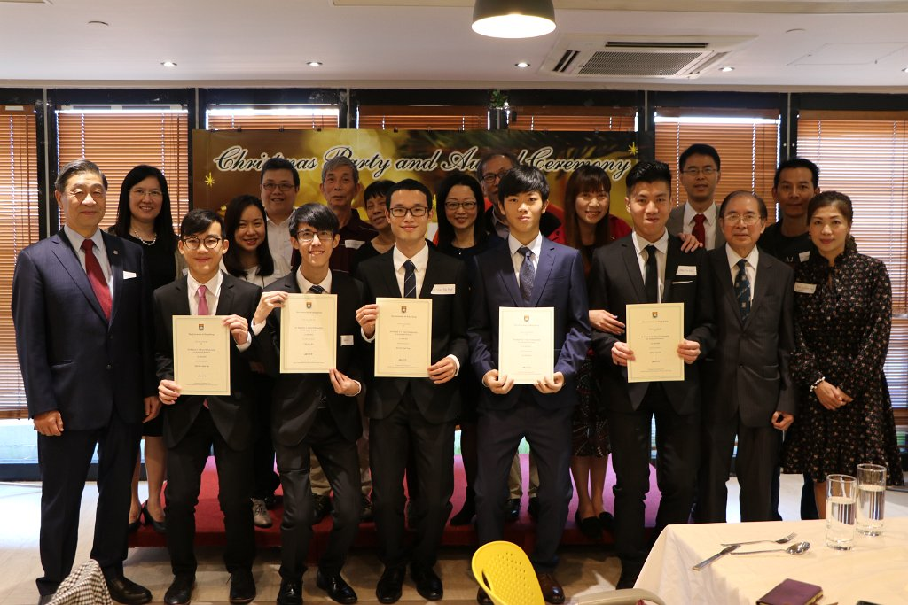
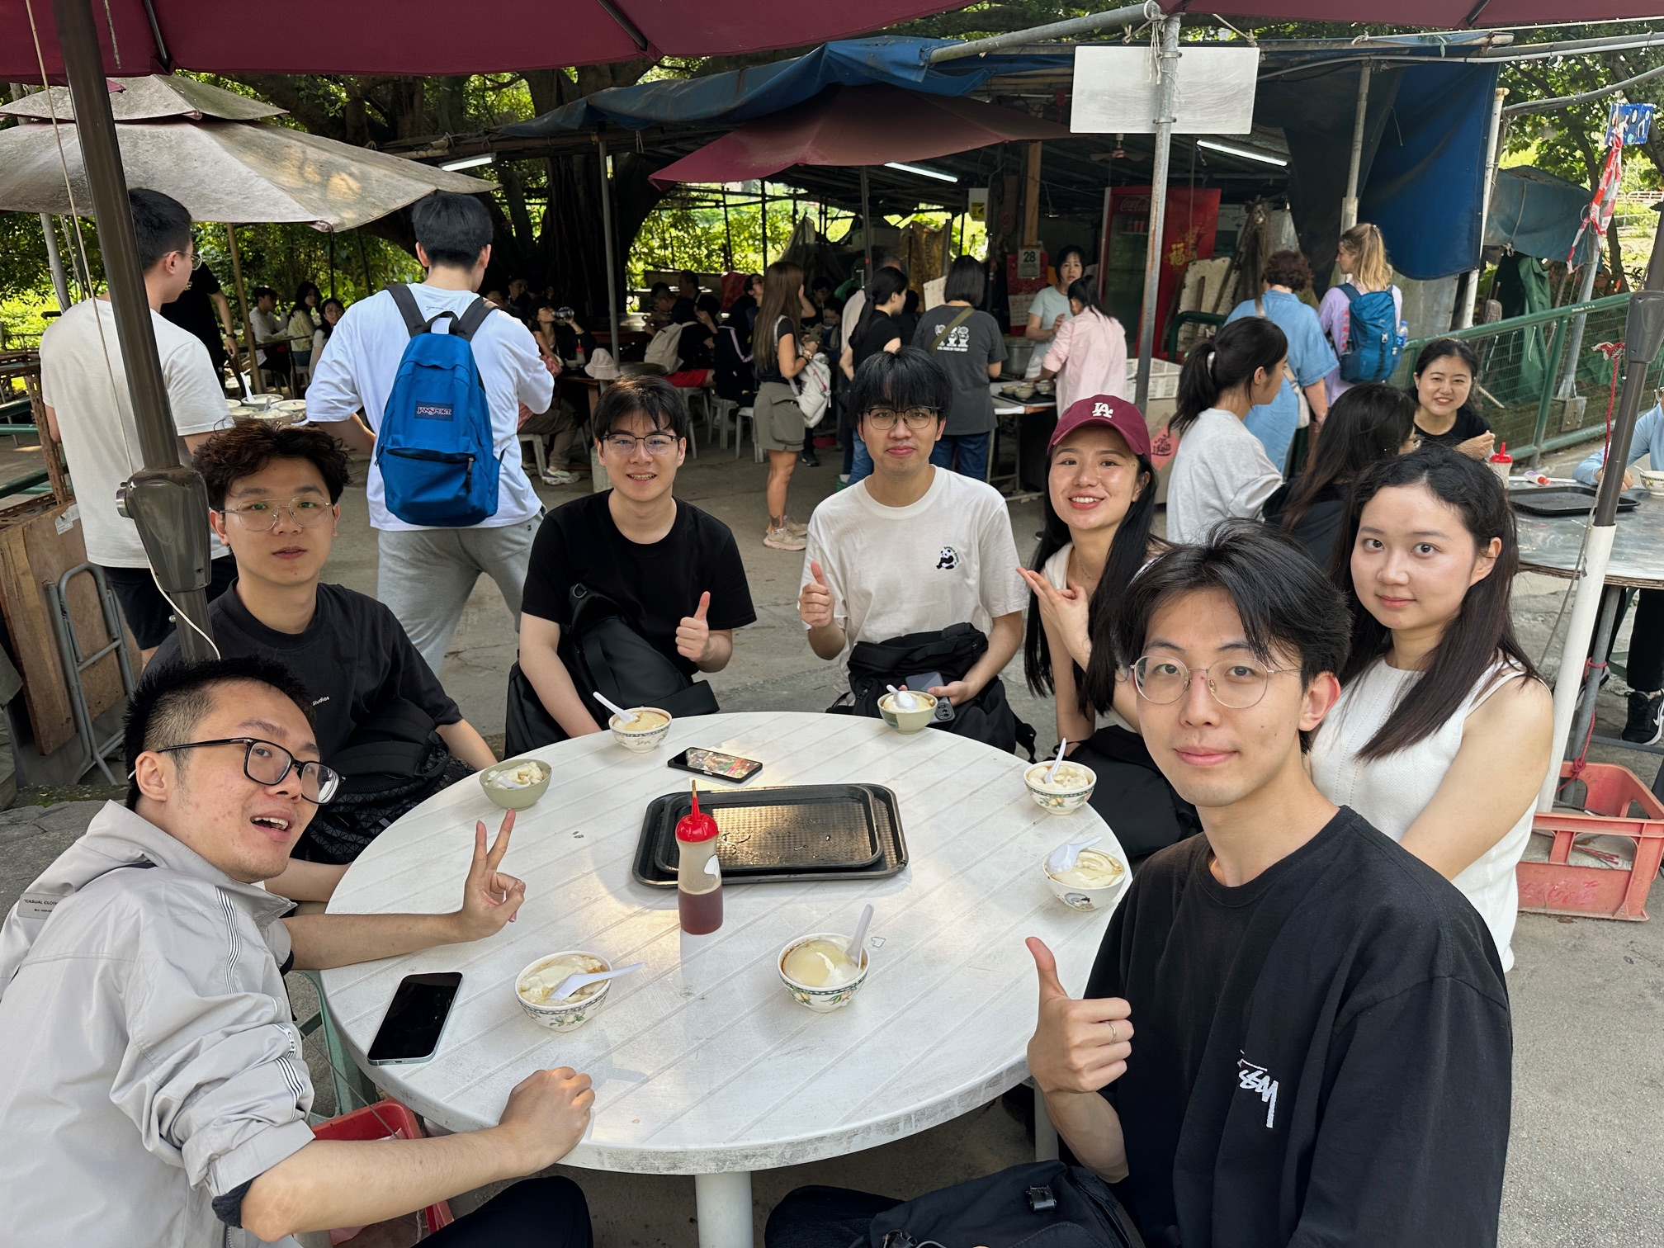
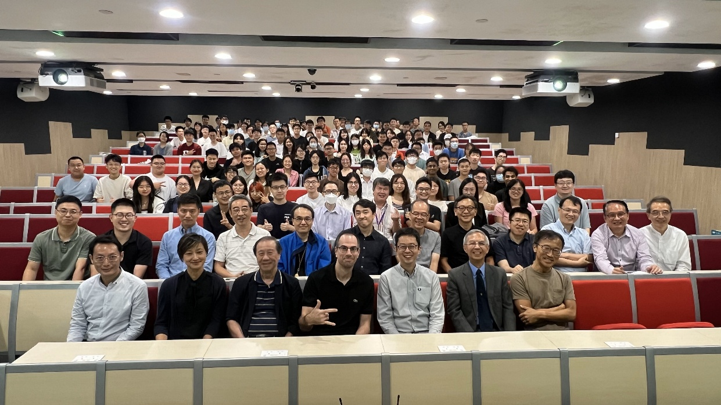
Welcome to our big family!
Wish you every success and
an enjoyable life at HKU!

